Slide 1
Tower collapsing simulation
Physics-Based Animation project pitch by Tom Cebula

Slide 2
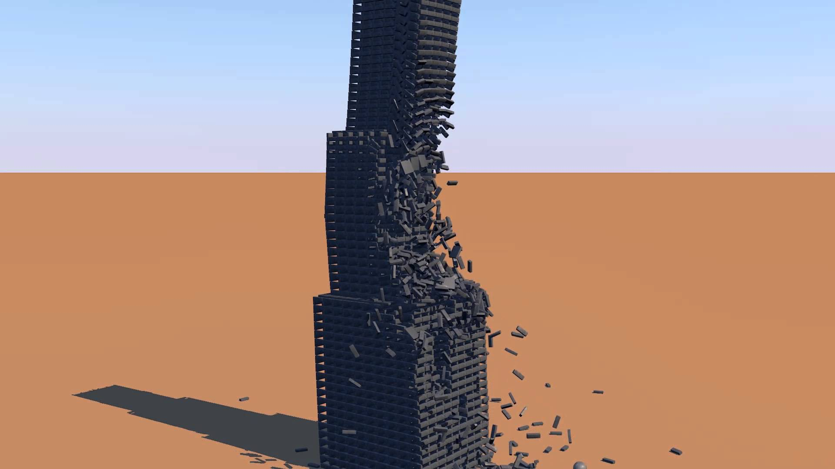
Hopefully something like this

Slide 3
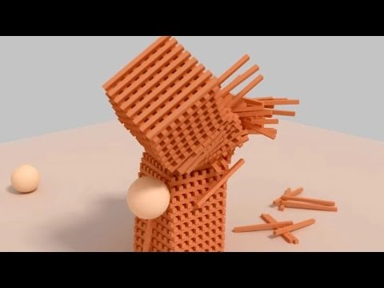
Inspiration video

Slide 4
Project Goals
Create a realistic simulation of a tower collapsing
Real time 30-60fps simulation
Hopefully will have an option to add more towers
Might add shadows to the scene if I have enough time left and if it won’t impact the fps too much

Slide 5
The physics behind it
Majority of the physics will be collision detection and forward dynamics as a lot of the blocks will be interacting with each other which will result with a change in forces, especially when the thrown object collides with the tower.
As the tower is hit, all the blocks affected will have to update their rotational variables according to:
the forces acted upon them by the thrown object
the blocks that collide with them as they fall down
Projectile Motion will also be used for the thrown object, with changeable variables as the user might have an option to change the thrown object’s forces

Slide 6
Rigid body simulation loop
Collision detection
Contact,
Time of impact
Forward Dynamics
Compute Accelerations and Inertia, Forces
Numerical Time Integration
Update velocity, position
SIGGRAPH2015_BulletIntro.ppt

Slide 7
Possible Enhancements
Option to add a lot more wooden blocks, making the towers bigger
Option to add more towers to the scene
Add explosions to the initial collision of the thrown object with the tower, sending the blocks flying
Add shadowing to all the objects
Option to change the variables of the thrown object, making it faster and heavier

Slide 8
Conclusion
I hope to create a realistic looking tower collapsing simulation that will run smoothly and look really cool at the same time.
I can also test the limits of the available hardware by adding many more blocks to the scene, hopefully I won’t set anything on fire.

